Slide 1

Single Top production in CMS: Lessons learned from Run-1 and future prospects
2^{d} CMS Single top workshop
4-5 December 2014
Naples, Italy
Rebeca Gonzalez Suarez
University of Nebraska, Lincoln

Slide 2
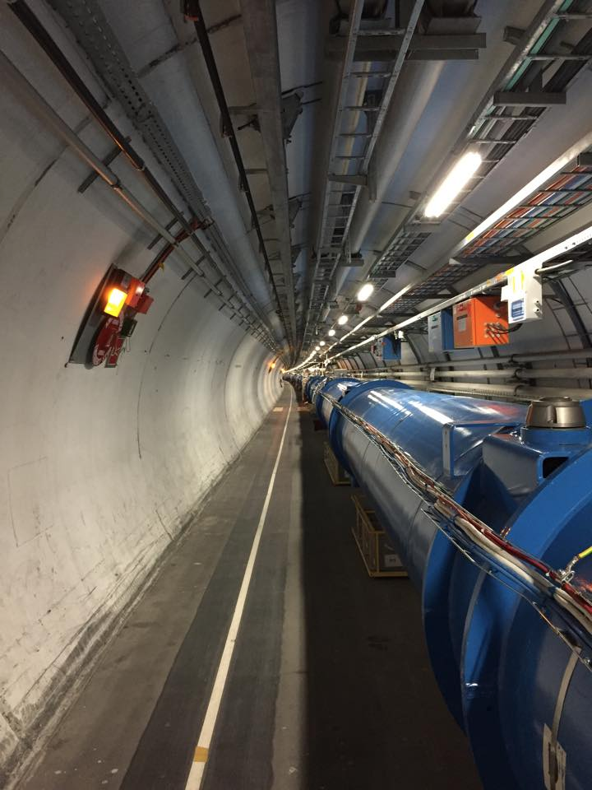

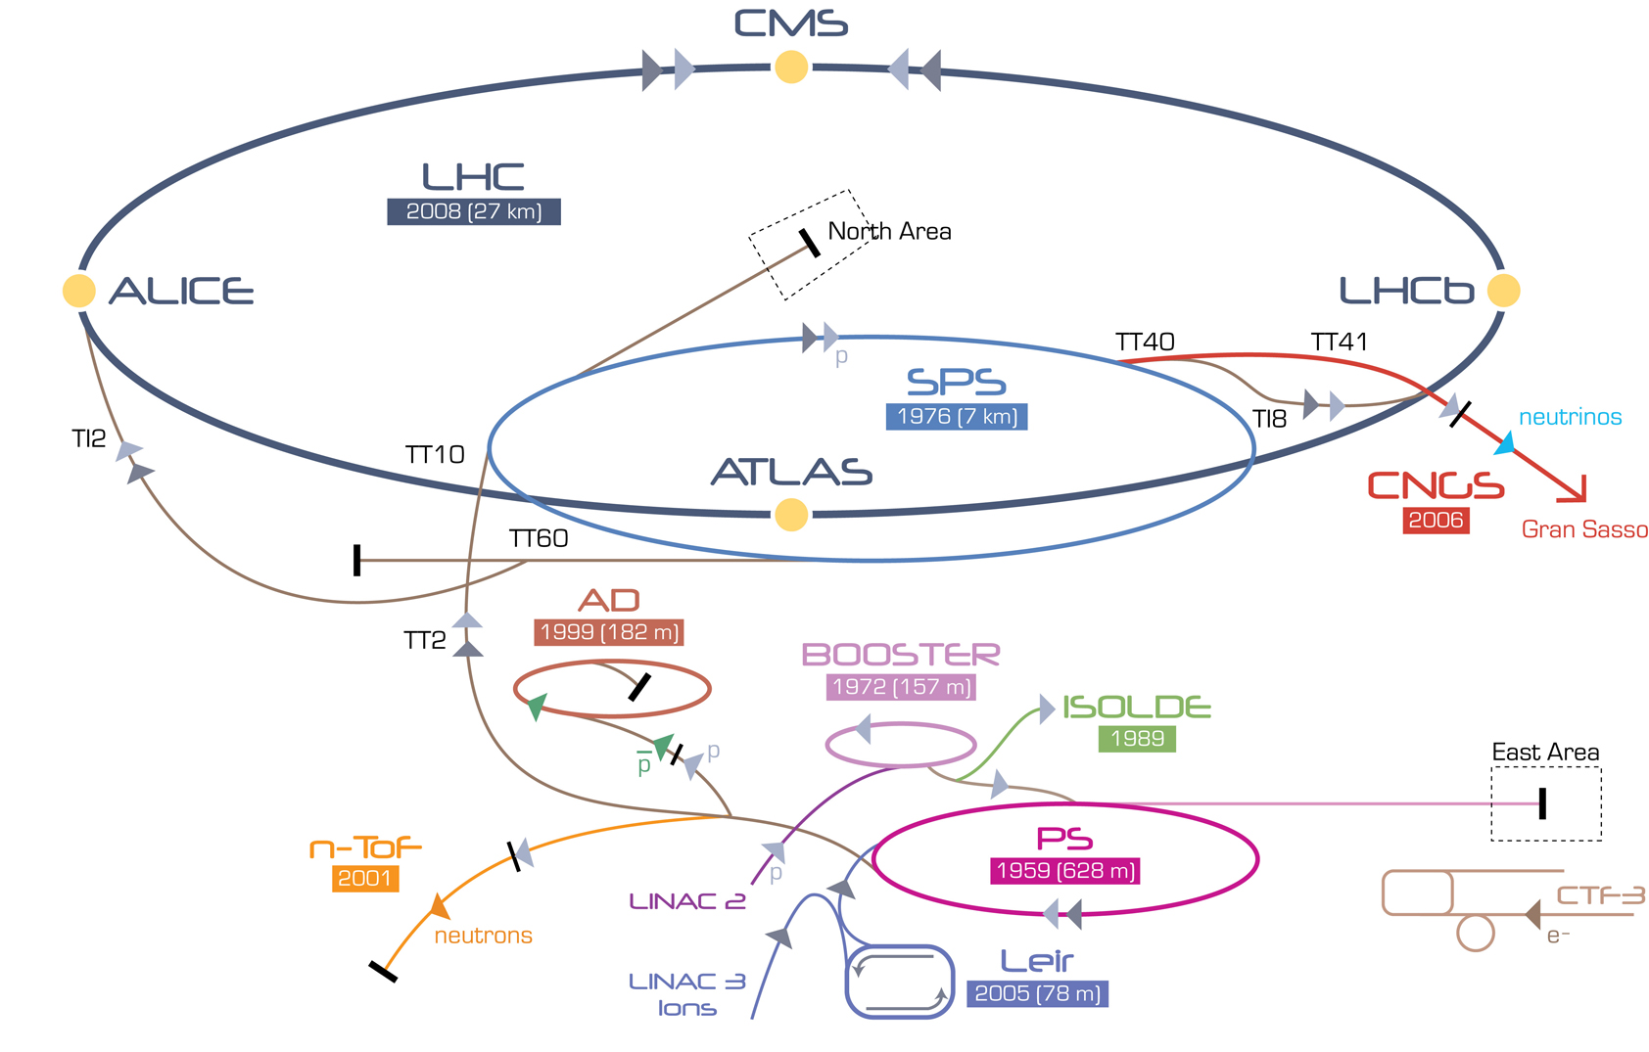

Run-1 of the LHC
The Run-1 of the LHC started in March 2010 and ended in February 2013
During three years:
~5fb⁻¹ at 7TeV and ~20fb⁻¹ at 8TeV of pp collisions
It was great for many reasons
For top physics in particular it was really good
Most obvious one, though it was not for ‘us’
t
t
t
t

Slide 3
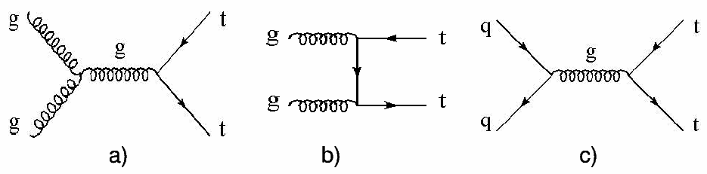
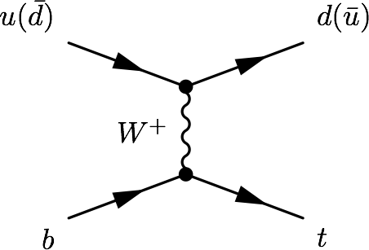
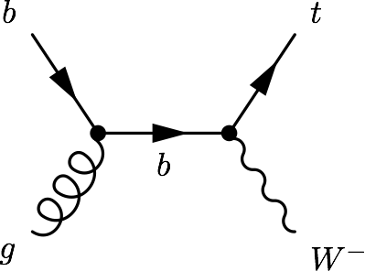
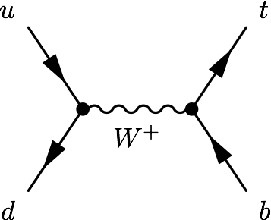
Top quark production at the LHC
Main production mode
→ ttbar pairs, via strong interaction (QCD)
(Tevatron 1995)
Alternative
→ single top quarks (EWK production), much smaller rate
(Tevatron 2009)
t-channel
tW
s-channel
σ [pb] | ttbar | t-channel | tW | s-channel
LHC (7 TeV) | 163 | 63.9 | 15.7 | 4.63
LHC (8 TeV) | 234 | 84.7 | 22.2 | 5.55

Slide 4
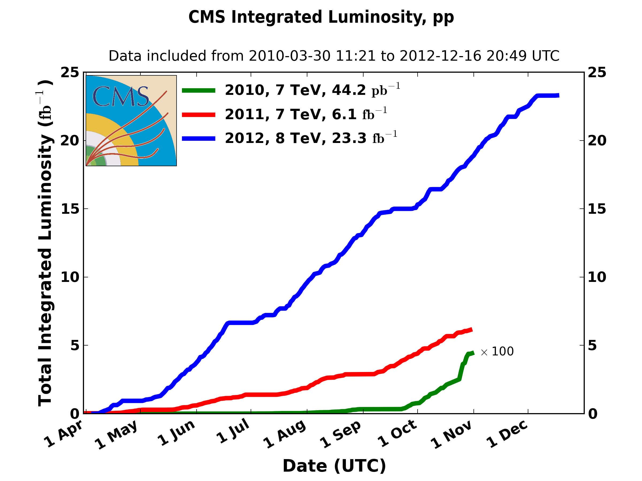
Run-1 in tops
This means that CMS has recorded:
More than 5M ttbar pairs
Around 2M of single top quarks (via t-channel)
And also:
Half a million of tW events and a bit more than 100K of s-channel events
CMS Single top spoiler alert:
This transforms into 6 papers published, several PASes made public (11 in the last two years), 2 LHC combinations, 1 discovery, and many milestones
And more results are planned before Run-2

Slide 5
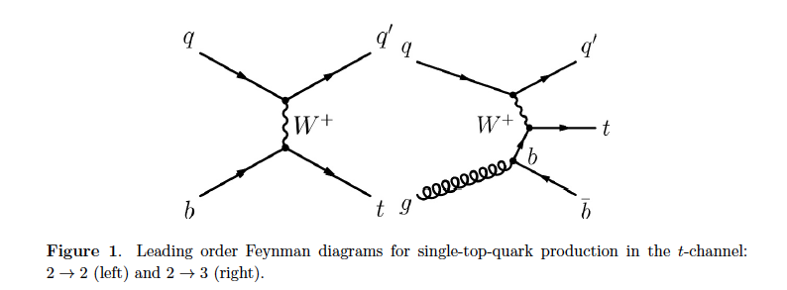
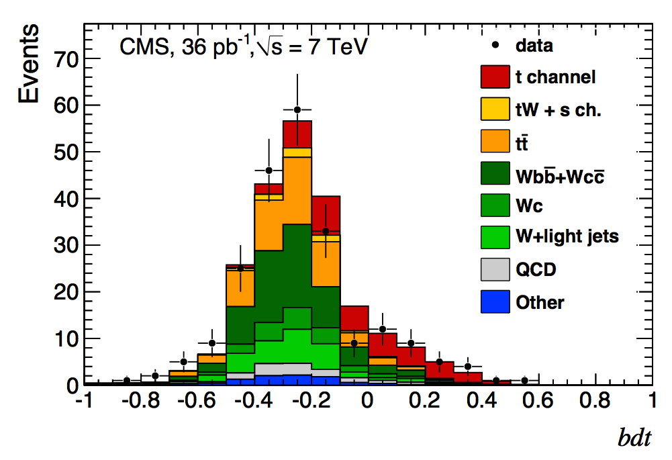
t-channel
Before the start of the Run-1
only t-channel production was observed at the Tevatron
It had taken the Tevatron 20 years to explore single top processes
In 2011, barely a year into collisions, CMS published its first t-channel paper
Jun 2011
Phys. Rev. Lett. 107:091802,2011
arXiv:1106.3052
t-channel
36pb⁻¹
2D (cosθ* η_{j’}) and BDT
1st lesson: the LHC truly is a top factory
In one year, power to explore processes that took the Tevatron decades

Slide 6
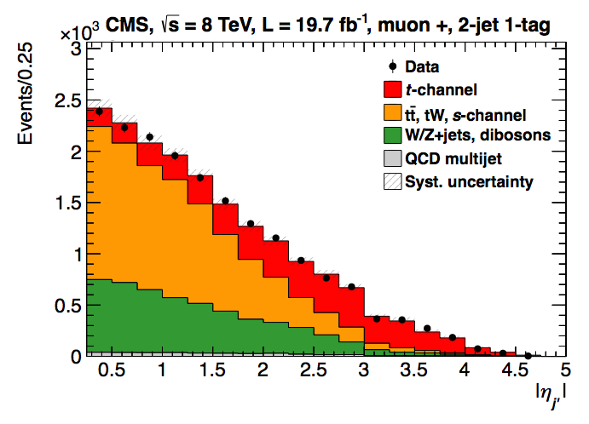
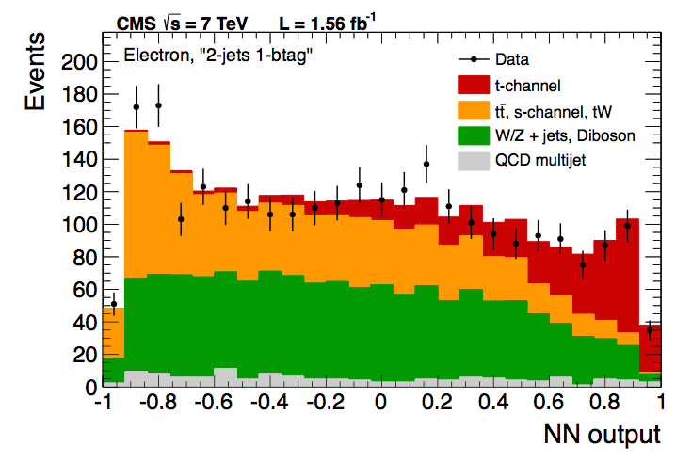
t-channel
CMS measured the inclusive t-channel cross section at 7 and 8 TeV
Including the ratio between top and anti-top, the measurement of |V_{tb}| and the ratio between center of mass energies
September 2012
JHEP 12 (2012) 035, arXiv:1209.4533
t-channel (η_{j’}, NN, BDT)
7TeV - 1.17 and 1.56 fb⁻¹
March 2014
JHEP 06 (2014) 090, arXiv:1403.7366
t-channel and |V_{tb}|, η_{j’}
8 TeV - 19.7fb⁻¹

Slide 7
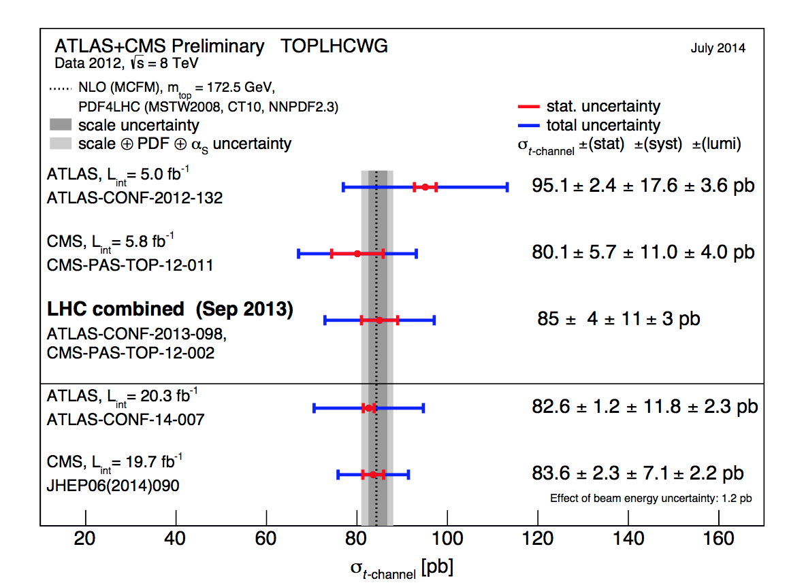
Combination with ATLAS
First LHC single top combination, within TOPLHCWG for TOP2013
ATLAS+CMS combination, 8TeV (September 2013)
Using Iterative BLUE
CMS-PAS-TOP-12-002
Lesson: we can cooperate with ATLAS and produce common results, though it takes effort from both sides

Slide 8
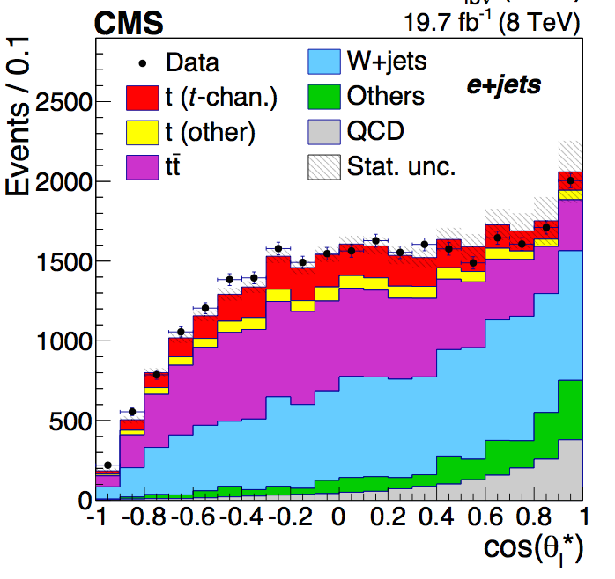
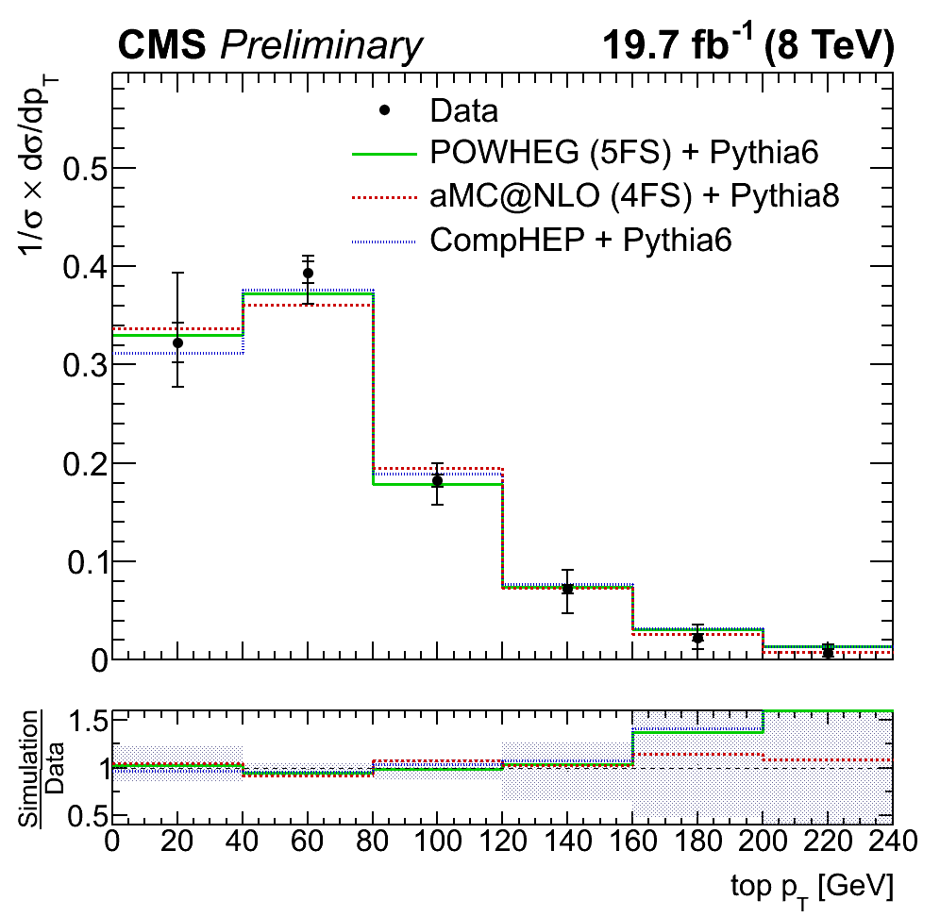
Top properties in t-channel
There are enough t-channel events to measure top properties in this signature
top width measurement in tt also used the inclusive t-channel cross-section
Phys. Lett. B 736 (2014) 33, arXiv:1404.2292 (April 2014)
First CMS (PAS and) paper of top properties in single top
First CMS single top differential
October 2014
Accepted by JHEP, arXiv:1410.1154
W boson helicity in t-channel
September 2014
CMS PAS TOP-14-004
Differential cross sections

Slide 9
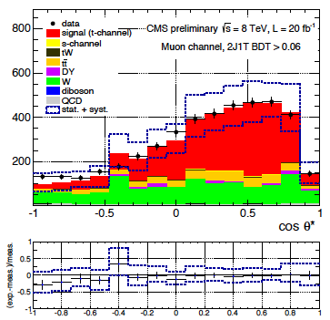
Coming up next!
Top quark polarization
Paper version of PAS
CMS-PAS-TOP-13-001
(September 2013)
Top mass
Michelangelo Mangano’s 2013 Christmas wish
ATLAS has a conf note (TOP2014)
ATLAS-CONF-2014-055
Fiducial t-channel cross sections
ATLAS has a conf note (March 2014)
ATLAS-CONF-2014-007
Lesson: single top t-channel is an excellent signature to make measurements and there’s a lot of information to extract from it

Slide 10
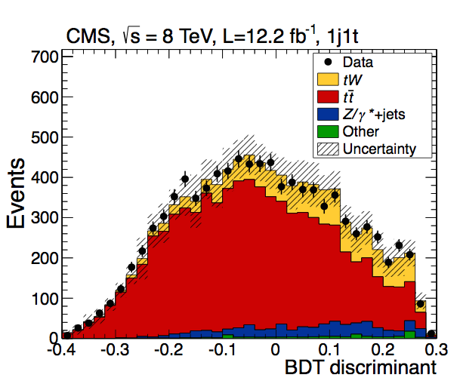
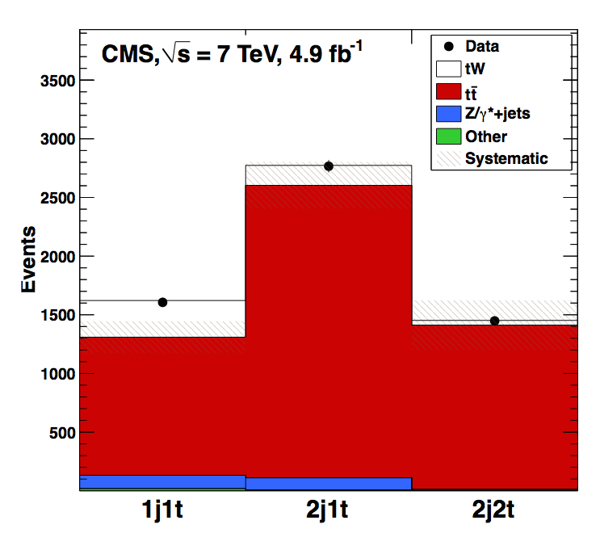
tW associated production
The low cross section of this process at the Tevatron made it impossible to study before the LHC
At the LHC is still not easy → only CMS has managed to observe it (> 5σ)
Evidence at 7TeV, discovery at 8TeV
2013 Milestone for CMS
EPS 2013
September 2012
Phys. Rev. Lett. 110 (2013) 022003
arXiv:1209.3489
(cut, BDT) 4.0σ 7TeV - 4.9fb⁻¹
January 2014
Phys. Rev. Lett. 112 (2014) 231802
arXiv:1401.2942
(BDT, shape, cut) 6.1σ 8TeV - 12.2fb⁻¹

Slide 11
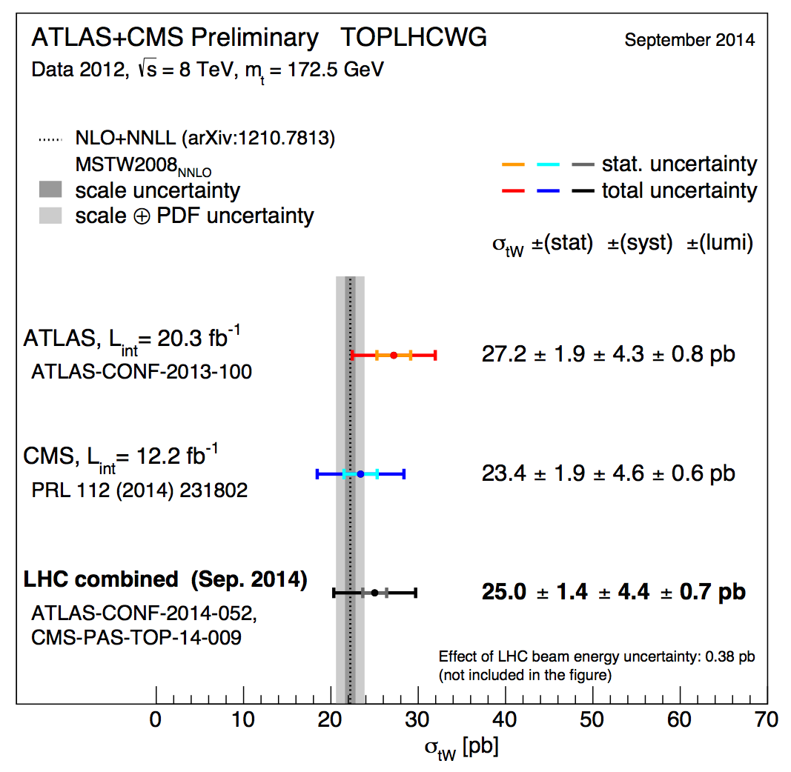
tW Combination with ATLAS
September 2014
PAS TOP-14-009
tW combination, 8TeV
Lesson: tW and ttbar are not easily separated (practically and theoretically), to understand and properly model the ttbar as background and its interference with the signal is the priority in this channel

Slide 12
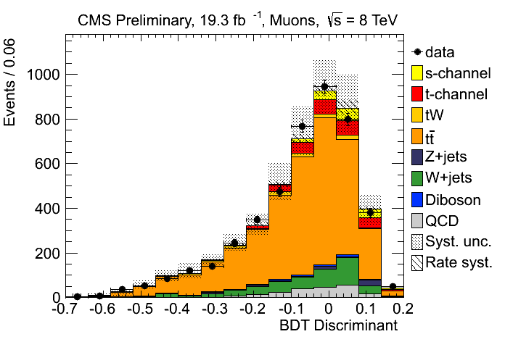
s-channel
Whereas the tW associated production has a larger production cross section, the s-channel becomes very challenging at the LHC
CMS has a PAS at 8TeV
CMS-PAS-TOP-13-009
(November 2013)
Full lumi, e and µ
S/B is a bit better at 7TeV
In Run-2 will become even harder
Better control of theory systematics would help → NLO Monte Carlo samples
Working on the paper version
First CMS result in this channel
PASCOS 2013
Lesson: the s-channel is a complex analysis with large tt background that requires a very good signal extraction

Slide 13
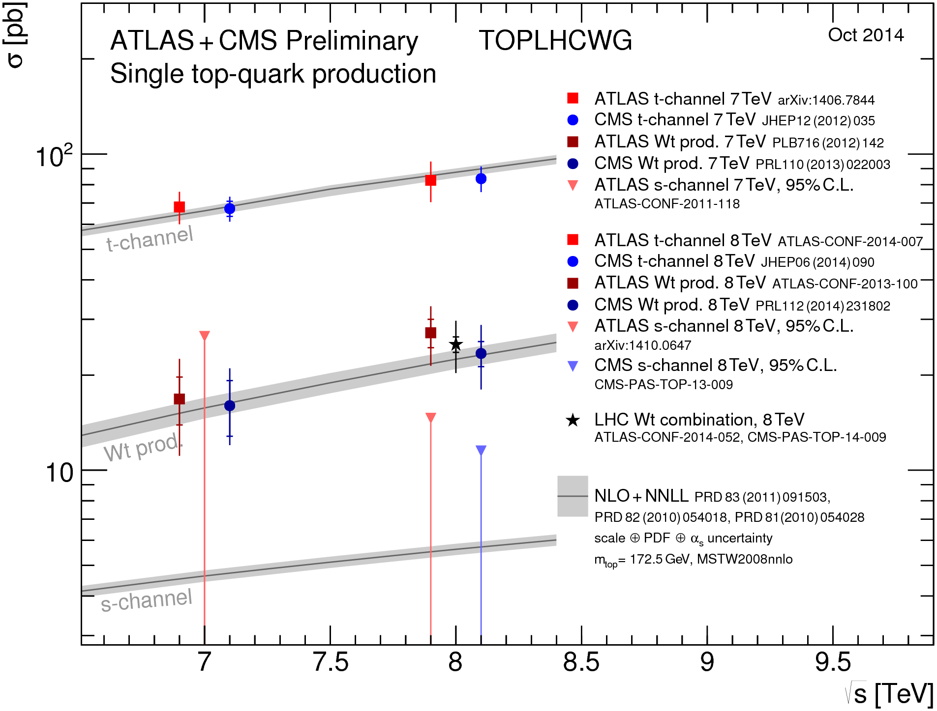
Summary plot
Lesson: To discuss with ATLAS before performing an analysis is better than to do it after

Slide 14
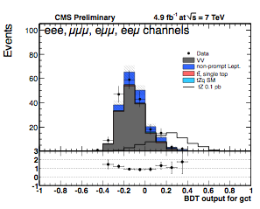
FCNC and Anomalous couplings
As you have seen today, limits on anomalous Wtb couplings can be extracted from SM measurements (W-helicity fractions, top polarization)
There are also dedicated analysis searching for FCNC in many signatures
FCNC tZ
BDT (gut, gct, Zut, Zct) 7TeV
Limits on couplings and branching fractions
CMS-PAS-TOP-12-021
(July 2013)
Work in progress towards a paper
First FCNC PAS in single top

Slide 15
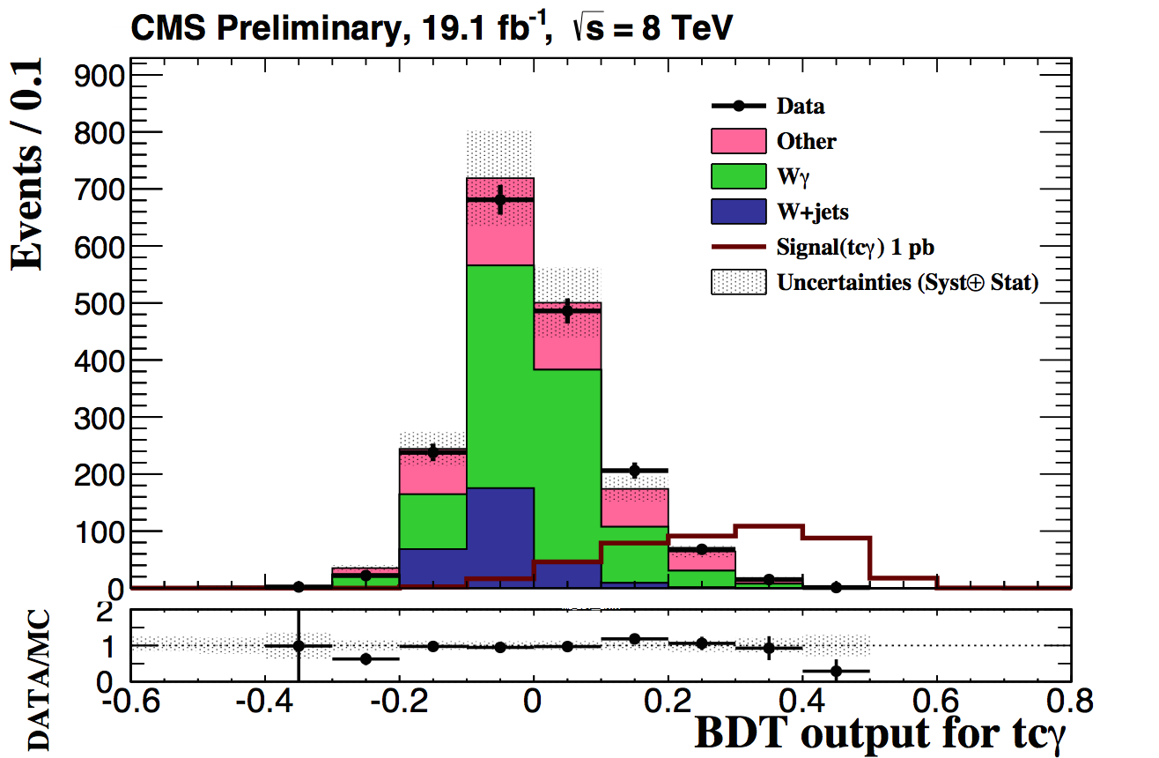
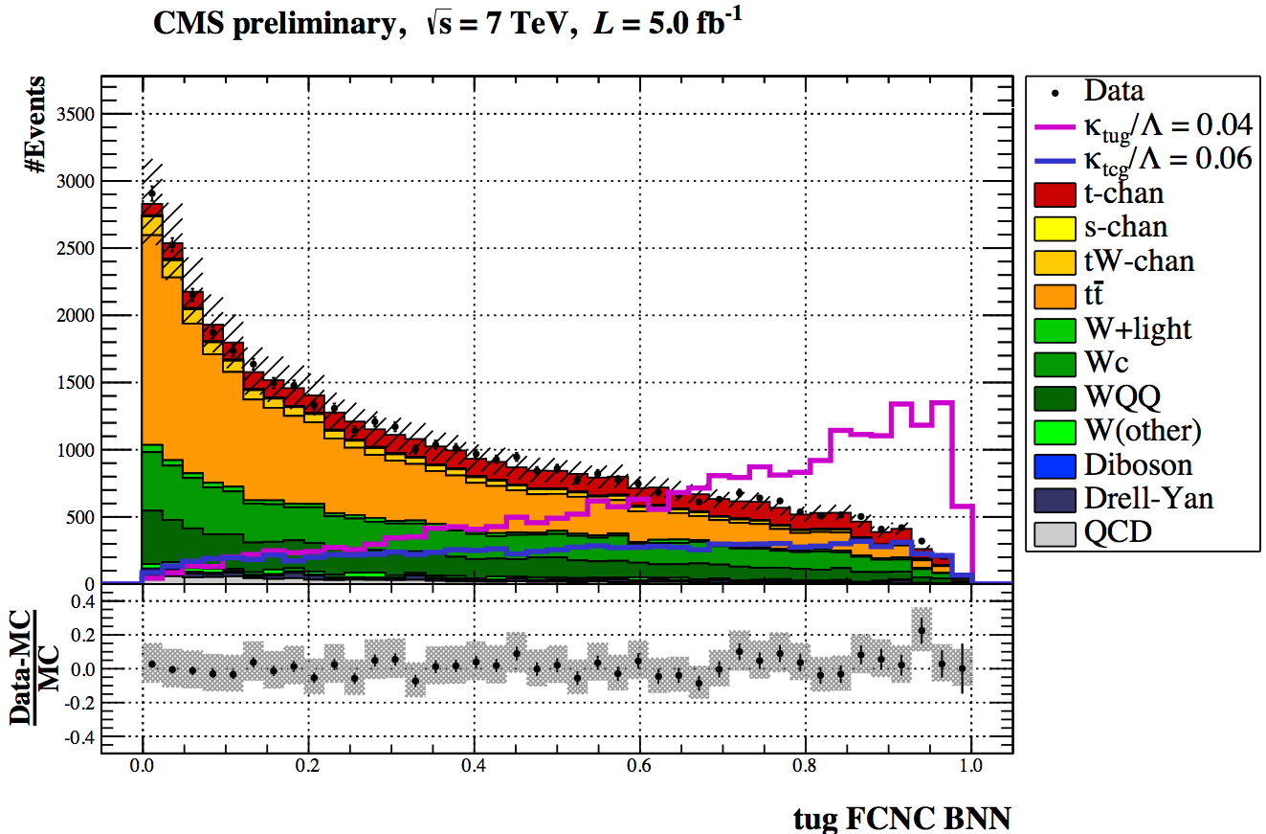
FCNC analyses
FCNC tqγ
CMS PAS-TOP-14-003
(May 2014)
tuγ, tcγ couplings
BDT 8TeV, µ
Work in progress towards a paper
FCNC in t-channel
CMS PAS-TOP-14-007
(May 2014)
7TeV, NN
tcg and tug
Work in progress towards a paper
Lesson: Single top signatures are ideal for AC and FCNC studies

Slide 16
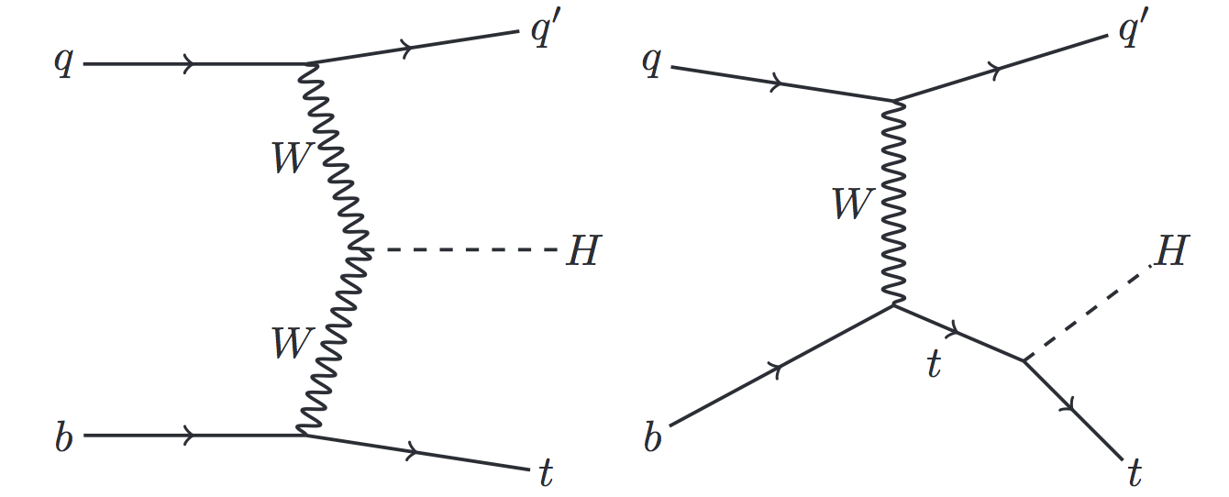
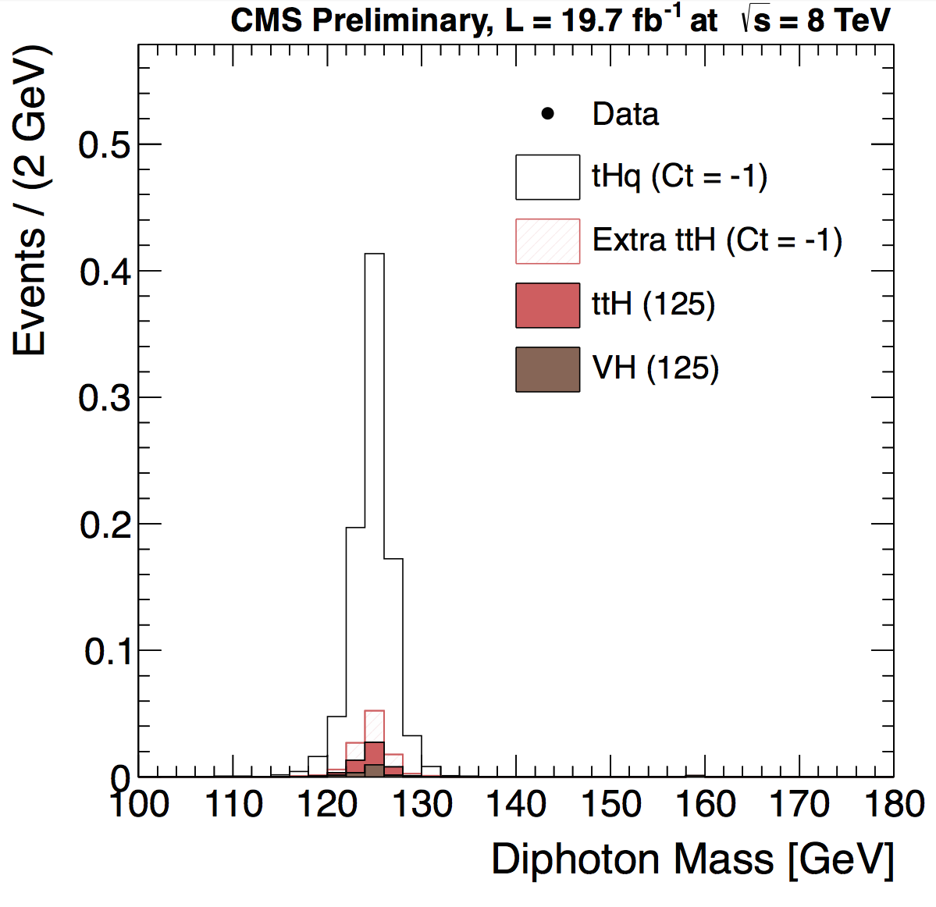
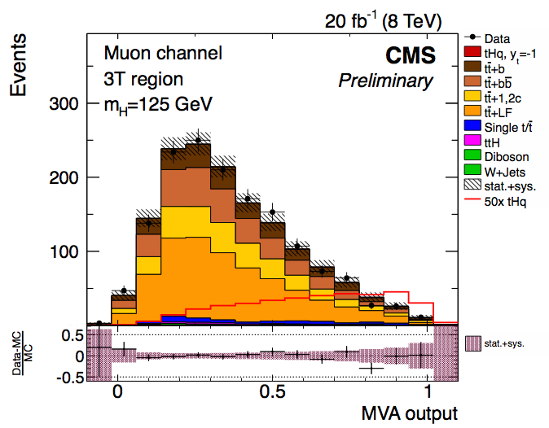
Top + Higgs
tH production highly suppressed in the SM
If top Higgs Yukawa coupling is negative → enhanced
tH, H→γγ
CMS PAS-HIG-14-001
(March 2013)
tH, H→bb
CMS PAS-HIG-14-015
(October 2014)
New channels to come!
Lesson: the top Higgs coupling can be studied in single top signature (not only in ttH)

Slide 17
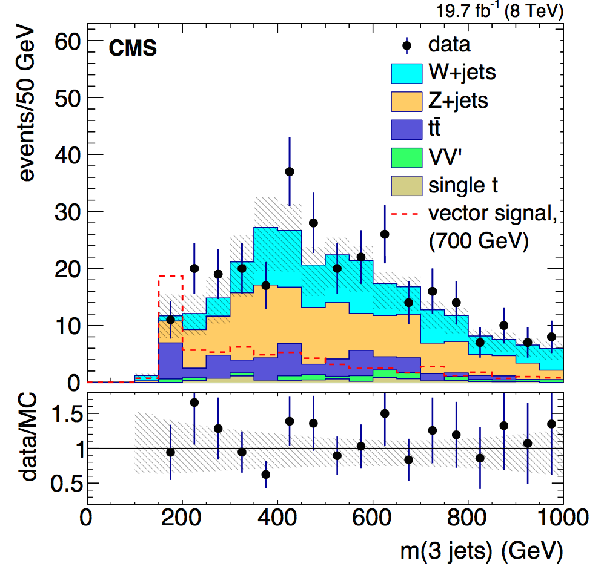
BSM top + X
There are many BSM channels that involve top quarks and/or similar signatures to single top, like W’→tb (arXiv:1402.2176)
Also some feature “single” top quarks
Monotop
DM search using top + MET
arXiv:1410.1149
(October 2014)
Lesson: We can already be sensitive to BSM in creative single top like channels with Run-1 data, Run-2 full of opportunities

Slide 18
What’s next
Finish the Run-1 analyses ongoing → several papers projected
There are open topics that could already be studied with Run-1 data and are uncovered, for example
Measurement of t and s-channel simultaneously
Study of tW + ttbar in dilepton final states simultaneously
CP violation measurement in single top decays
With the higher luminosity and center of mass energies of Run-2 (Run-3, Run-4…)
Minimizing systematics and improve modelling
Face new challenges like high pileup scenarios
Measurement of properties in purer samples (“precision” era)
SM processes with low production rates (tZ for example) will become accessible
More BSM channels could also be explored, larger phase space to test

Slide 19
Run-2
Run-2 will start late Spring 2015
Will run for ~3 years providing about 300fb⁻¹ at 13 (14) TeV
t-channel:
SM candle
flagship for the single top group
Could be done ~1fb⁻¹ → High Priority Analysis (HPA) for Run-2
Next → tW (~3fb⁻¹)
May be the surprise of Run-2 with a larger growth in cross section than the other modes
Exploring tt and tW interplay → Run-2 goal
Properties from 5fb⁻¹
σ [pb] | t-channel | tW | s-channel
LHC (7 TeV) | 63.9 | 15.7 | 4.63
LHC (8 TeV) | 84.7 | 22.2 | 5.55
LHC (13TeV) | 217 | 71.2 | 11.3

Slide 20
Summary
The LHC Run-1 has been highly successful for single top physics
Many public results:
The three main production modes (t-channel, tW, s-channel)
Top properties in t-channel (W-helicities, top polarization)
Anomalous couplings and FCNC
Top+Higgs production constraining the top-Higgs Yukawa coupling
BSM searches involving single top quarks
ttbar background omnipresent in all single top studies
to model and understand this process (as well as the signal) → priority
Open collaboration with ATLAS in LHC combination
Effort in harmonization, improvement in techniques and estimations
Wrapping up Run-1 results, getting ready for Run-2
→ Tune in tomorrow to see the process of the ongoing analyses!

